Slide 1

Foreign Direct Investment Analysis
By
Manthan Sharma

Slide 2
Problem Statement
Investment is a game of understanding historic data of investment objects under different events but it is still a game of chances to minimize the risk we apply analytics to find the equilibrium investment.
To understand the Foreign direct investment in India for the last 17 years from 2000-01 to 2016-17. This dataset contains sector and financial year-wise data of FDI in India Sector-wise investment analysis Year-wise investment analysis.
Find key metrics and factors and show the meaningful relationships between attributes. Do your own research and come up with your findings

Slide 3
Dashboard Analysis

Slide 4
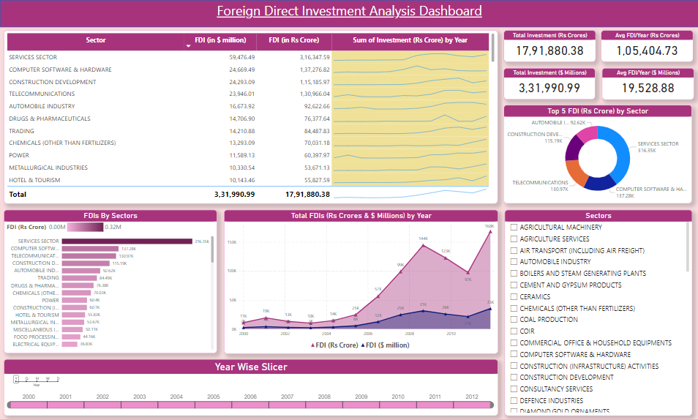
DASHBOARD
Foreign Direct Investment Analysis Dashboard

Slide 5
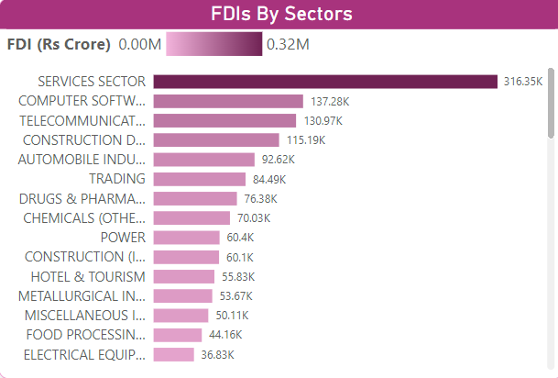
Analysis
FDIs By Sectors
Services Sector stood with the highest FDI of Rs 3,16,347.59 Crores.
Out of all the 63 FDIs, Services Sector accounted for 17.65% of th total amount invested.
COIR accounted for the least FDI with an amount of only Rs 21.64 Crores.

Slide 6
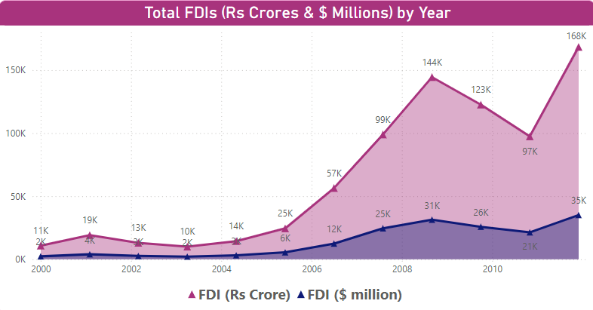
Analysis
Total FDIs By Year
The FDI graph tended up between between the year 2000 and 2011.
FDI (Rs Crores) started tending up in the month of June, 2005, rising by 586.25% in 6.50 years.
FDI ($ millions) jumped from 3218.69 to 35,120.78 during it’s steepest incline between May, 2004 and December, 2011.

Slide 7
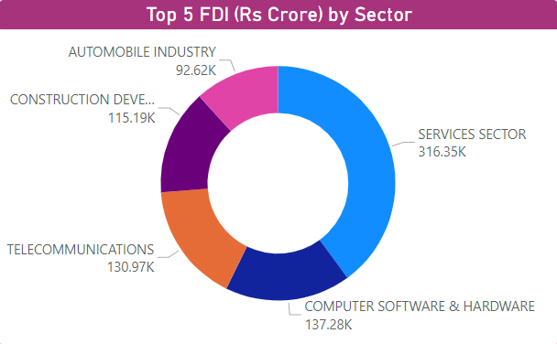
Analysis
Top 5 FDIs By Sector
The Top 5 FDIs were from –
Services Sector
Computer Software and Hardware
Telecommunications
Construction Development
Automobile Industry
Out of which Services Sector accounted for 39.92% of the total Investments.

Slide 8
Summary
Services Sector stood with the highest FDI of Rs 3,16,347.59 Crores.
Out of all the 63 FDIs, Services Sector accounted for 17.65% of th total amount invested.
The Top 5 FDIs were from –
Services Sector
Computer Software and Hardware
Telecommunications
Construction Development
Automobile Industry
Out of which Services Sector accounted for 39.92% of the total Investments.

Slide 9
Thank You
Presented By –
Manthan Sharma
manthans2001@gmail.com

